Slide 1

Hundred years of Air Crash Narratives: Key Findings
Subasish Das, Ph.D.
Associate Transportation Researcher
Library and Information Science for Transportation Committee | ABG40 Meeting
January 11, 2017

Slide 2
Overview
Problem statement
Text Mining and Topic Modeling
Summary
Future research

Slide 3
Problem Statement
Crash narratives explain the details of an occurred crash.
Limited research has been conducted on the prospects of using crash narratives in safety analysis.
Mining textual data can identify research trends and unconventional knowledge from the unstructured data. Simple exploratory data analysis is not enough.
Topic model is an algorithmic model for discovering "topics" that occur in a set of documents. Developing topic models using air crash narratives have not been attempted yet.

Slide 4
Sample Crash Narrative
Date: 1 June, 2009
Airline: Air France (Airbus A330-203)
Location: Atlantic Ocean, 570 miles northeast of Natal, Brazil
Aboard: 228, Survived: 0
Crash Narrative:
The Airbus went missing over the Atlantic Ocean on a flight from Rio de Janeiro to Paris, France. The plane departed from Rio de Janeiro-Galeao International Airport at 19:03 LT bound for Charles de Gaulle Airport in Paris. The last radio contact with the flight was at 01:33 UTC. The aircraft left CINDACTA III radar coverage at 01:48 UTC, flying normally at FL350. The aircraft reportedly went through a thunderstorm with strong turbulence at 02:00 UTC. At 02:14 UTC an automated message was received indicating a failure of the electrical system. The plane carried 12 crew members and 216 passengers.

Slide 5
Data
Hundred years (1908-2009) of air crash narrative data
Variables in the dataset:
Date
Year
Time
Location
Operator
Flight
Route
Type
Registration
Aboard
Killed
Ground
Crash narratives

Slide 6
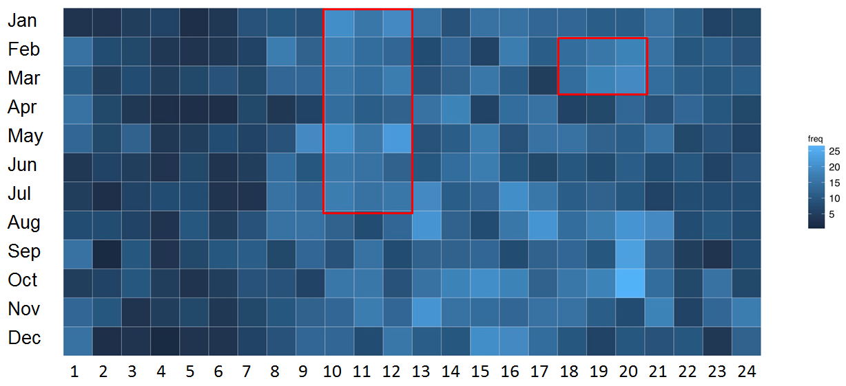
Month and Hour of the Day

Slide 7
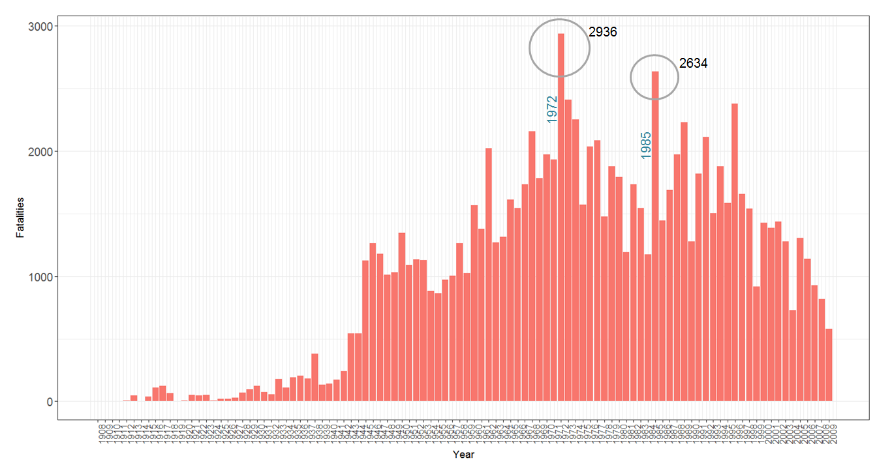
Air Crash Fatalities
1908-2009

Slide 8
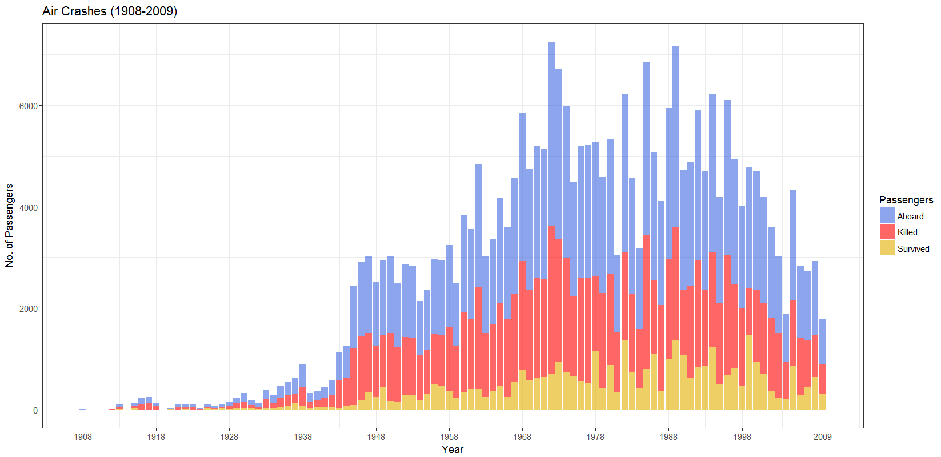

Slide 9
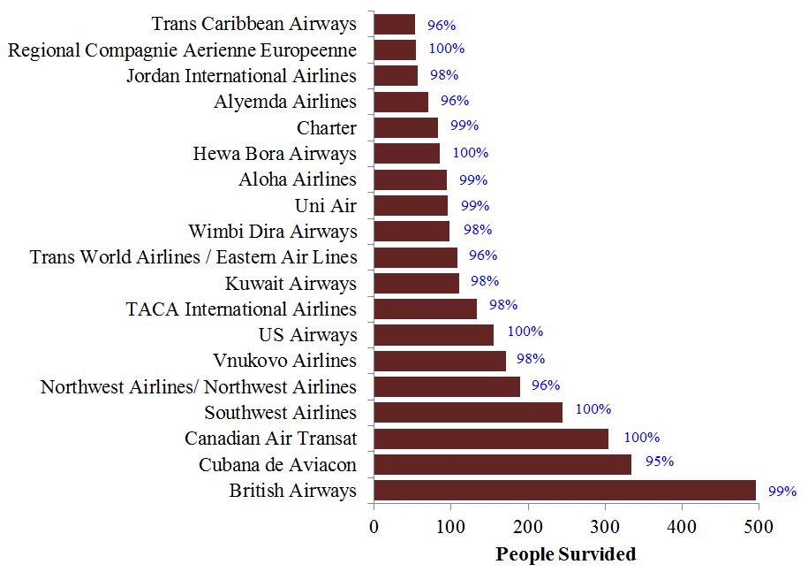
No. of survived passengers by Air Lines

Slide 10
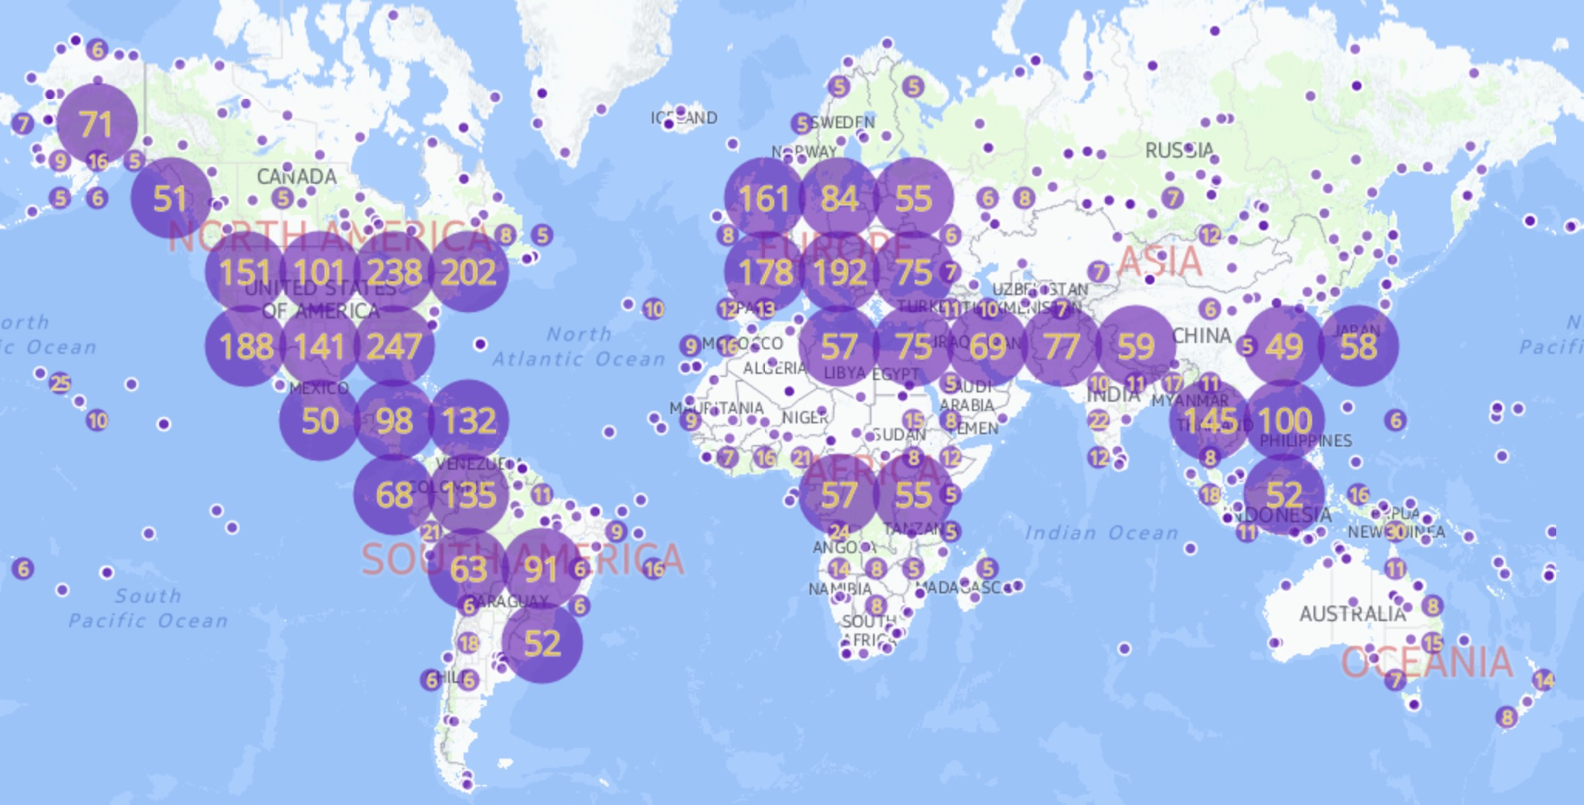

Slide 11
Text Mining
Information Extraction
Semantic Metadata
Knowledge Discovery
Semantic Mining
Information Collection
The purpose of text
mining is to convert
unstructured textual
content into knowledge.
It is a part of natural
language processing.
The outputs are:
Patterns or trends
Word clouds
Word networks
Topic models
Explicit knowledge
Input
Output
Document or
Corpus
Vocabulary
Trends
Or
Topic Models

Slide 12
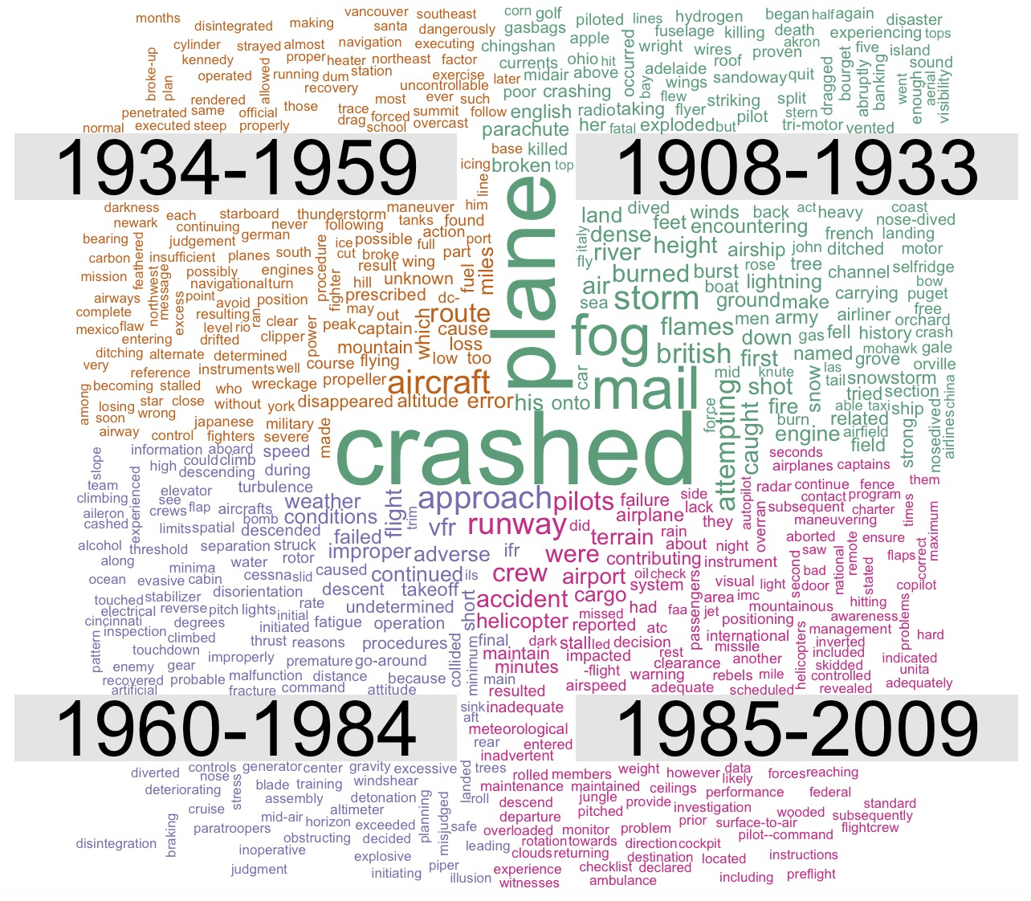
Word Cloud
Word cloud illustrates
frequencies of the words
in different documents.
In this analysis, the timeline
is divided into four groups.
Size of a word is
proportional to its
frequencies in the documents.
For generating word clouds,
primary level of data cleaning
was performed.

Slide 13
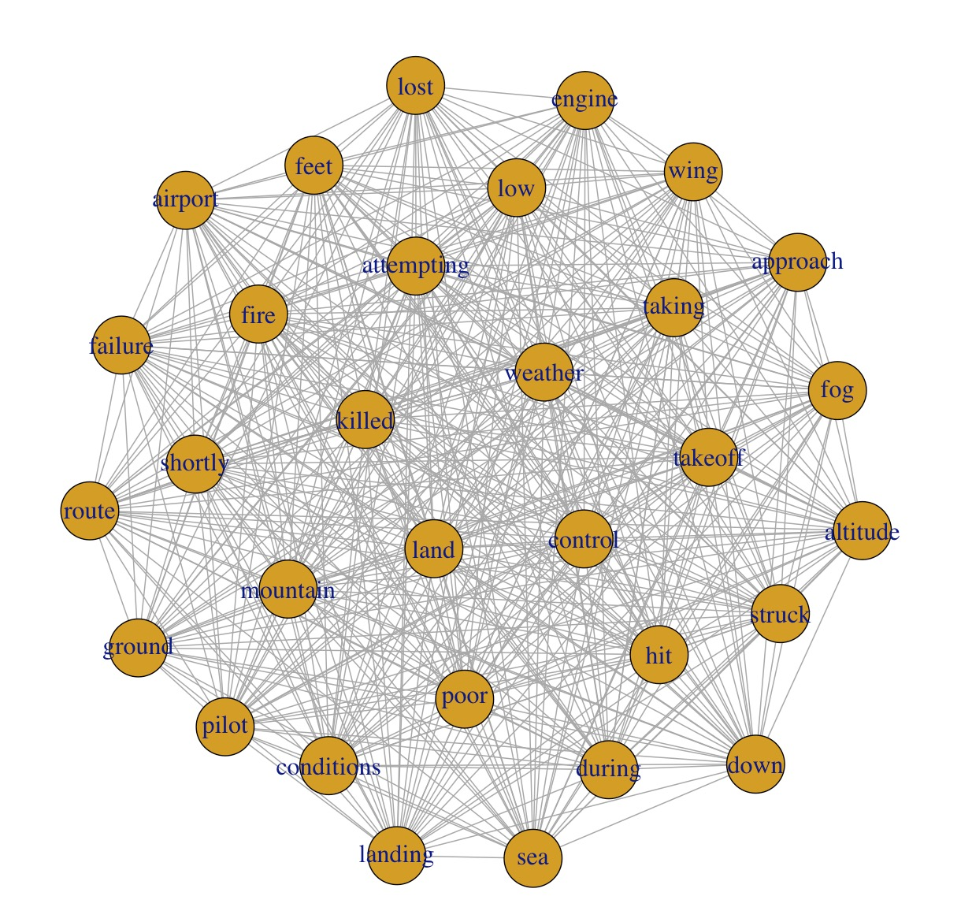
Word Network
Word network shows the
correlation between associated
words.
The word network developed
from final dataset is complex.
No particular association is
found significant.

Slide 14
What is topic model?
Topics
Visibility =0.5
Reduced= 0.2
Most of the information used by drivers is acquired visually. In spite of its importance, visibility conditions at the time of a crash are often not documented at a high level of detail. A quantified investigation of the visibility level at the time of a crash was undertaken to investigate the increase in risk associated with driving during periods of reduced visibility. The study method blended data collected from the National Oceanic and Atmospheric Administration (NOAA) with reported crashes in Florida. From the thousands of logged weather events collected by NOAA, the researchers isolated time periods of normal visibility and comparable time periods of reduced visibility in a matched-pairs study. The crash data were contained in the Roadway Information Database (RID) compiled for the Strategic Highway Research Program 2 (SHRP2). The RID contains several geometric and traffic variables that allow for analyses to account for effects of factors other than visibility. The findings indicate that, as expected, the likelihood of a crash increases during periods of low visibility, despite the tendency for less traffic and lower speeds to prevail during these times.
Crash =0.2
Increase= 0.13

Slide 15
Topic Models
Algorithms for discovering trends from a large and unstructured collection of documents
Organize the collection according to the discovered themes
Latent Dirichlet Allocation (LDA), simplest and most popular topic model, is a statistical model of document collections that tries to capture this intuition.
LDA lacks additional document-level information on which variation can be seen in different theoretical interests.
In this study, structural topic model (STM) was used. This algorithm uses metadata or document level information.

Slide 16
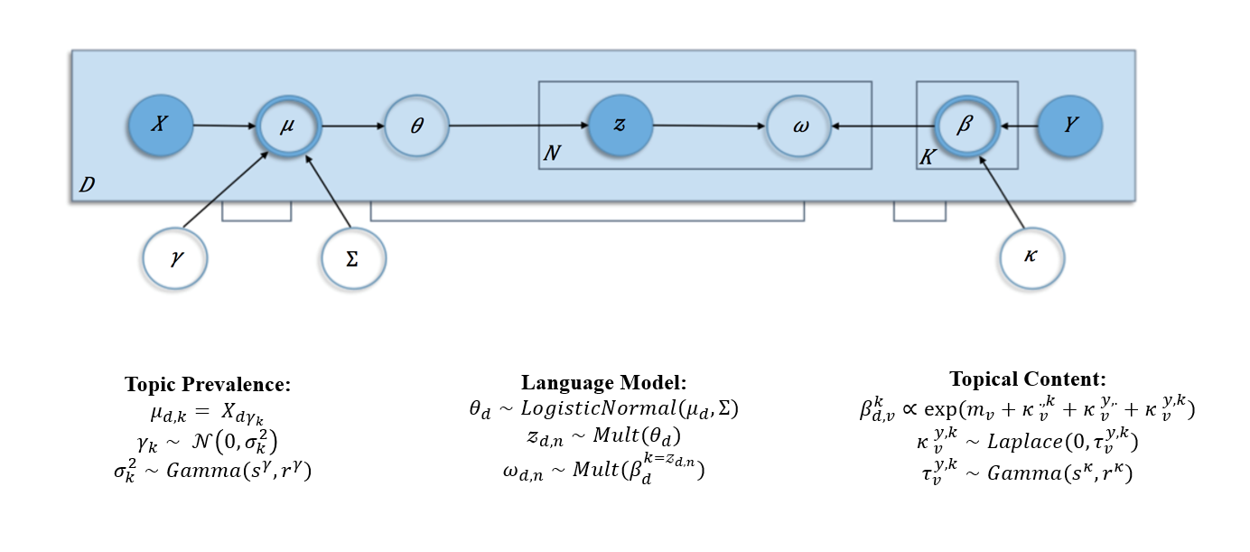
Theory of Structural Topic Model

Slide 17
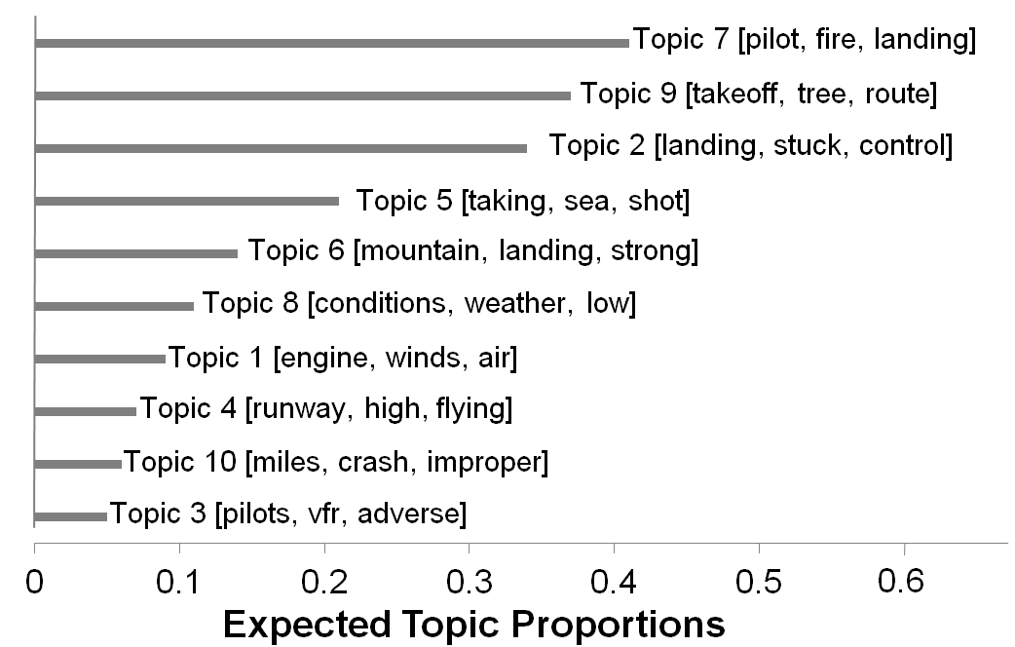
Top 10 Topic Models

Slide 18
Summary
This study develops a framework for analyzing crash narratives.
Word cloud on preliminary clean dataset indicates presence of few redundant terms like crash, plane, aircraft.
For developing topic model, redundant words are removed from analysis. Document level metadata (location, flight type, and operator) was used to develop more definite topic models.
Top trends from the models:
Fire related crash
Tree on route
Landing related crash
Shot on sea
Mountain related crash

Slide 19
My Publications on Text Analytics
Journal Publications:
Das, S., K. Dixon, X. Sun, A. Dutta, and M. Zupancich. Trends in Transportation Research: Exploring Content Analysis in Topics. TRR (under review).
Das, S., and X. Sun. Text Mining and Topic Modeling on Compendium Papers from Transportation Research Board Annual Meetings. Transportation Research Record: Journal of the Transportation Research Board Jan 2016, Vol. 2552, pp. 48-56.
Das, S, X. Sun, and A. Dutta. Investigating User Ridership Sentiments for Bike Sharing Programs. JTTS, Vol.5 No.2, 2015.
Conference Proceedings:
Das, S., X. Sun, A. Dutta, and M. Zupancich. Twitter in Circulating Transportation Information: A Case Study on Two Cities. TRB 96th Annual Meeting, Washington D.C., 2017.

Slide 20
Dataset to use for Future Research
TxDOT Crash Narratives
SHRP-2 Final Narratives vs. Driver Narratives
Transportation Research Record Papers
TRID
Google News on Self Driving Cars

Slide 21
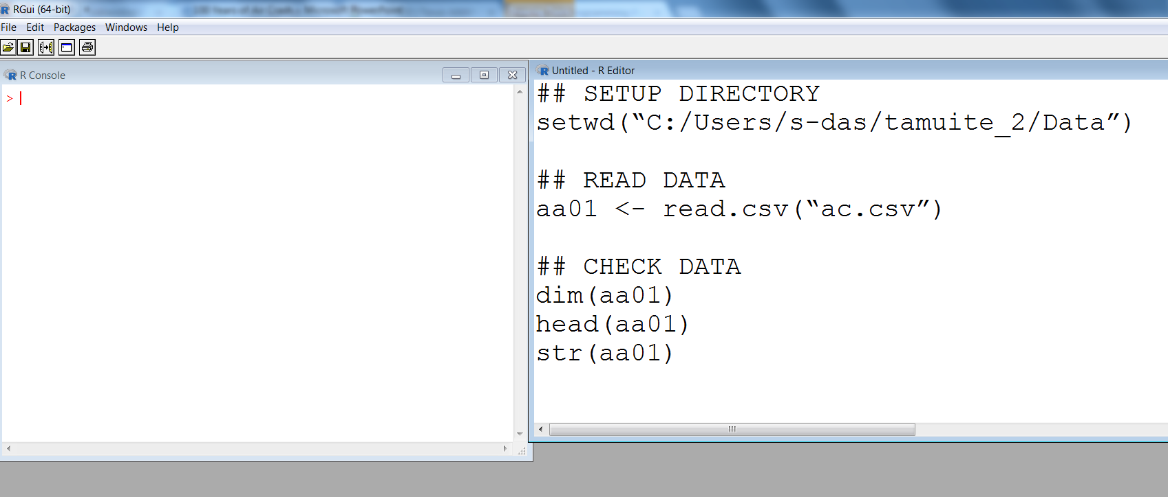
R: How to Read Data
## SETUP DIRECTORY
setwd(“C:/Users/s-das/tamuite_2/Data”)
## READ DATA
aa01 <- read.csv(“ac.csv”)
## CHECK DATA
dim(aa01)
head(aa01)
str(aa01)

Slide 22
Open R or RStudio

